Slide 1
Visualizing ConvNet
Dr. Noman Islam

Slide 2
Introduction
It’s often said that deep-learning models are “black boxes”: learning representations that are difficult to extract and present in a human-readable form
it’s definitely not true for convnets
The representations learned by convnets are highly amenable to visualization, in large part because they’re representations of visual concepts

Slide 3
Three Techniques for Visualization
Visualizing intermediate convnet outputs (intermediate activations)
Useful for understanding how successive convnet layers transform their input, and for getting a first idea of the meaning of individual convnet filters.

Slide 4
Visualizing convnets filters
Useful for understanding precisely what visual pattern or concept each filter in a convnet is receptive to.

Slide 5
Visualizing heatmaps of class activation in an image
Useful for understanding which parts of an image were identified as belonging to a given class, thus allowing you to localize objects in images
Let’s discuss each of them one by one

Slide 6
Visualizing intermediate activations
Visualizing intermediate activations consists of displaying the feature maps that are output by various convolution and pooling layers in a network, given a certain input
This gives a view into how an input is decomposed into the different filters learned by the network.

Slide 7
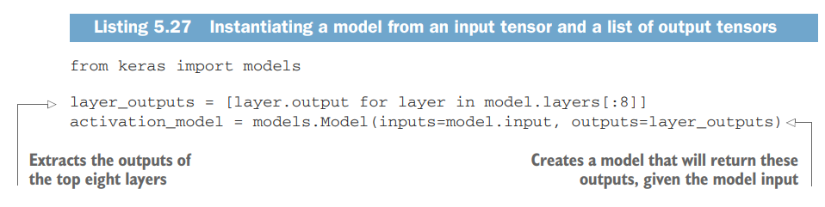

Slide 8
When fed an image input, this model returns the values of the layer activations in the original model.

Slide 9
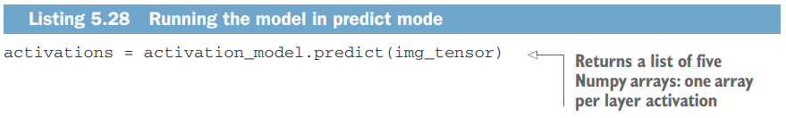

Slide 10
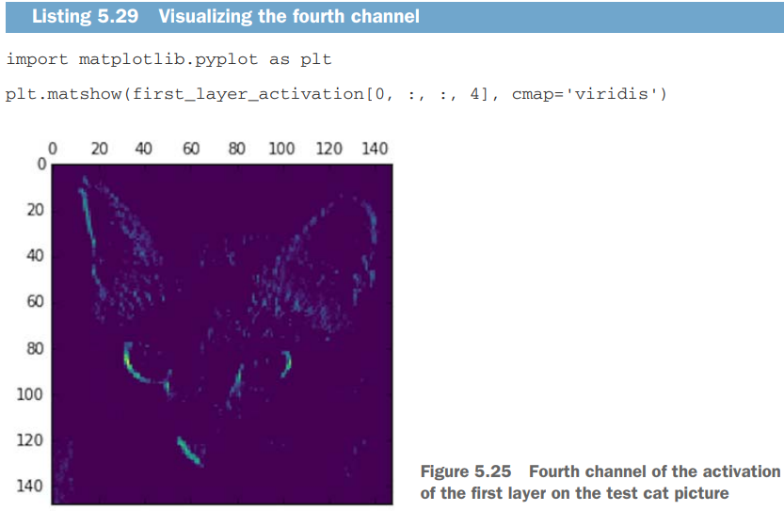
This channel appears to encode a diagonal edge detector.

Slide 11

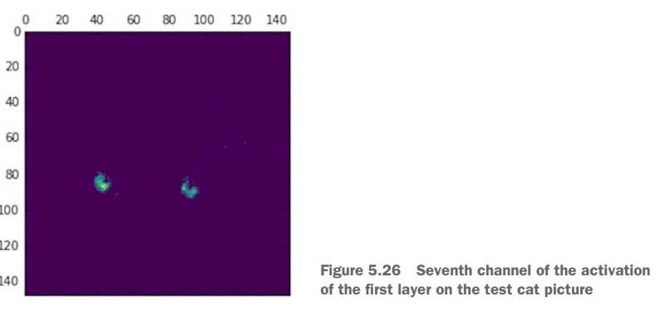

Slide 12
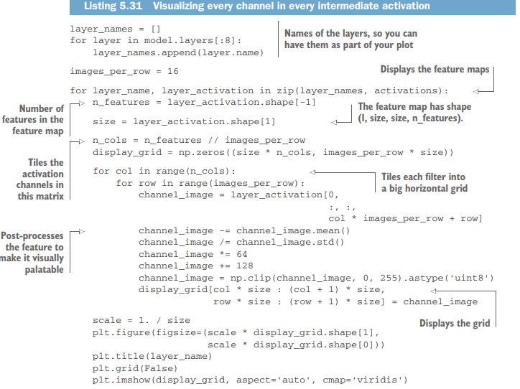

Slide 13
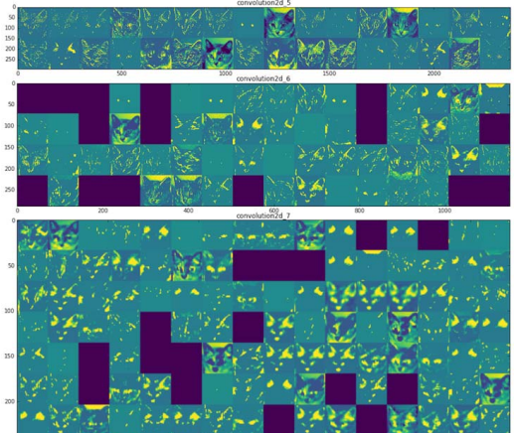

Slide 14
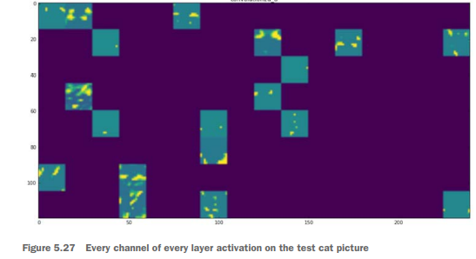

Slide 15
Layers become increasingly abstract
There are a few things to note here:
The first layer acts as a collection of various edge detectors. At that stage, the activations retain almost all of the information present in the initial picture.
As you go higher, the activations become increasingly abstract and less visually interpretable. They begin to encode higher-level concepts such as “cat ear” and “cat eye.” Higher presentations carry increasingly less information about the visual contents of the image, and increasingly more information related to the class of the image.

Slide 16
The sparsity of the activations increases with the depth of the layer: in the first layer, all filters are activated by the input image; but in the following layers, more and more filters are blank. This means the pattern encoded by the filter isn’t found in the input image.

Slide 17
Property of deep neural network
We have just evidenced an important universal characteristic of the representations learned by deep neural networks: the features extracted by a layer become increasingly abstract with the depth of the layer.
The activations of higher layers carry less and less information about the specific input being seen, and more and more information about the target (in this case, the class of the image: cat or dog).

Slide 18
Information distillation pipeline
A deep neural network effectively acts as an information distillation pipeline, with raw data going in (in this case, RGB pictures) and being repeatedly transformed so that irrelevant information is filtered out (for example, the specific visual appearance of the image), and useful information is magnified and refined (for example, the class of the image).

Slide 19
Visualizing filters
Another easy way to inspect the filters learned by convnets is to display the visual pattern that each filter is meant to respond to.
This can be done with gradient ascent in input space: applying gradient descent to the value of the input image of a convnet so as to maximize the response of a specific filter, starting from a blank input image.
The resulting input image will be one that the chosen filter is maximally responsive to.

Slide 20
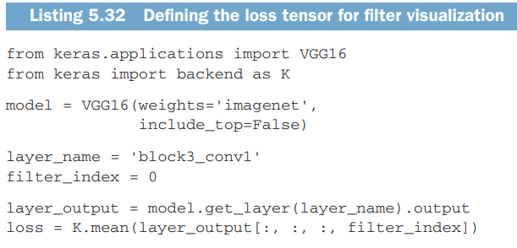

Slide 21
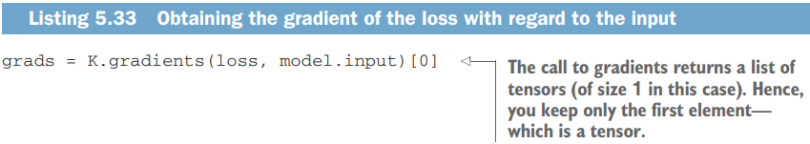
Applying gradient to loss function
To implement gradient descent, you’ll need the gradient of this loss with respect to the model’s input. To do this, you’ll use the gradients function packaged with the backend module of Keras.

Slide 22
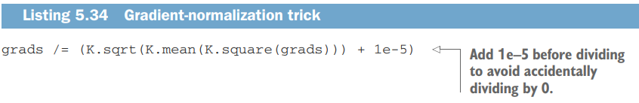
Normalization
A non-obvious trick to use to help the gradient-descent process go smoothly is to normalize the gradient tensor by dividing it by its L2 norm (the square root of the average of the square of the values in the tensor). This ensures that the magnitude of the updates done to the input image is always within the same range.

Slide 23
Now you need a way to compute the value of the loss tensor and the gradient tensor, given an input image. You can define a Keras backend function to do this: iterate is a function that takes a Numpy tensor (as a list of tensors of size 1) and returns a list of two Numpy tensors: the loss value and the gradient value.

Slide 24
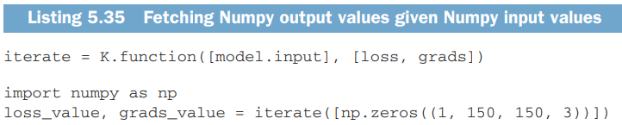

Slide 25
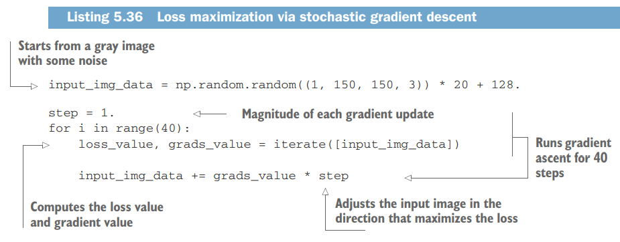

Slide 26
Post-process image tensor
The resulting image tensor is a floating-point tensor of shape (1, 150, 150, 3), with values that may not be integers within [0, 255]. Hence, you need to postprocess this tensor to turn it into a displayable image.

Slide 27
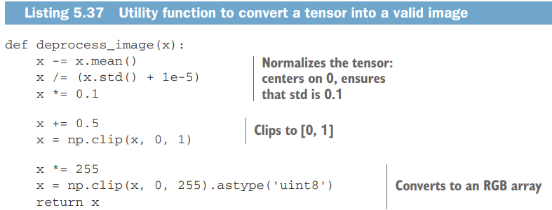

Slide 28
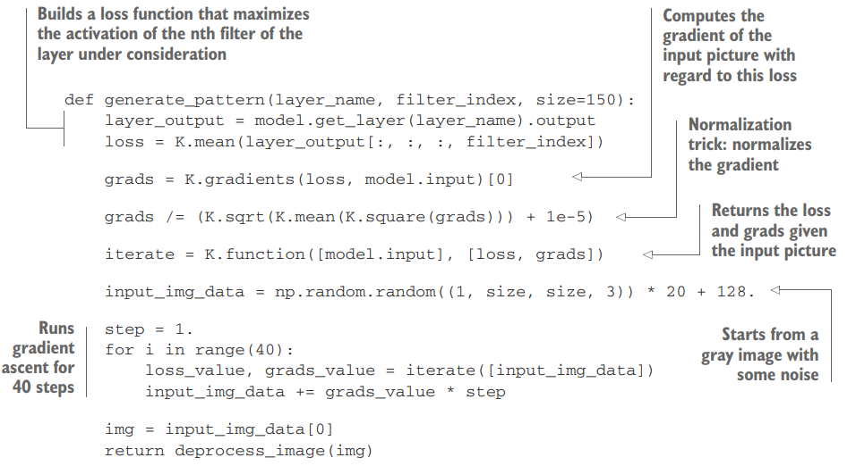

Slide 29
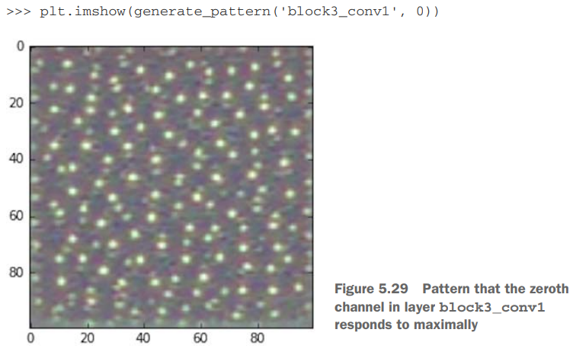

Slide 30
It seems that filter 0 in layer block3_conv1 is responsive to a polka-dot pattern.
Now the fun part: you can start visualizing every filter in every layer.

Slide 31
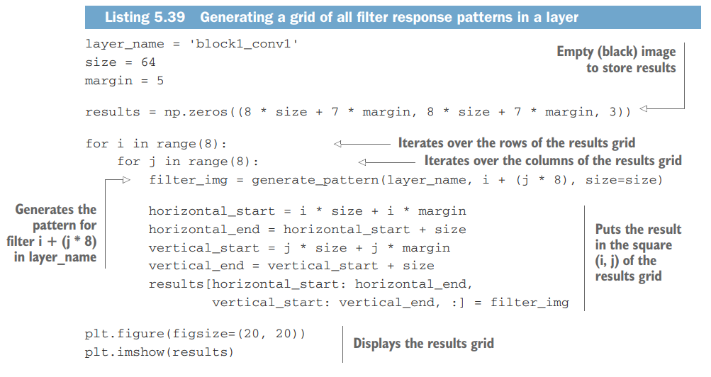

Slide 32
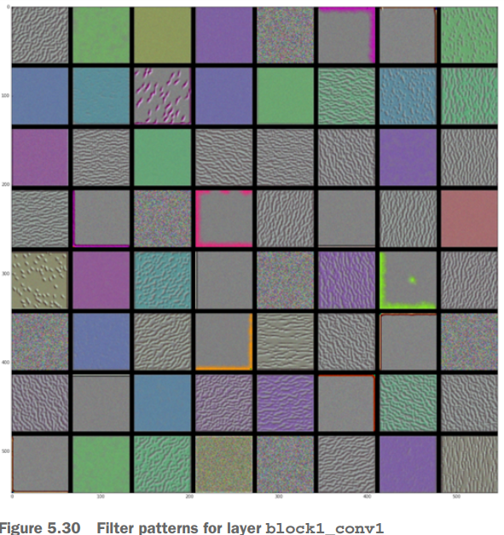

Slide 33
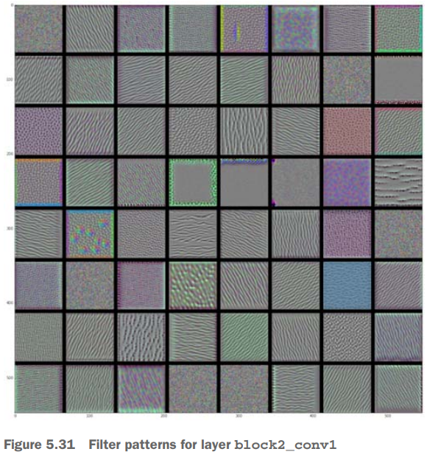

Slide 34
Filters are like Fourier transform
These filter visualizations tell you a lot about how convnet layers see the world: each layer in a convnet learns a collection of filters such that their inputs can be expressed as a combination of the filters.
This is similar to how the Fourier transform decomposes signals onto a bank of cosine functions.
The filters in these convnet filter banks get increasingly complex and refined as you go higher in the model

Slide 35
The filters from the first layer in the model (block1_conv1) encode simple directional edges and colors (or colored edges, in some cases).
The filters from block2_conv1 encode simple textures made from combinations of edges and colors.
The filters in higher layers begin to resemble textures found in natural images: feathers, eyes, leaves, and so on.

Slide 36
Visualizing heatmaps of activation class
One that is useful for understanding which parts of a given image led a convnet to its final classification decision.
This is helpful for debugging the decision process of a convnet, particularly in the case of a classification mistake.
It also allows you to locate specific objects in an image

Slide 37
CAM visualization
This general category of techniques is called class activation map (CAM) visualization, and it consists of producing heatmaps of class activation over input images.
A class activation heatmap is a 2D grid of scores associated with a specific output class, computed for every location in any input image, indicating how important each location is with respect to the class under consideration

Slide 38
For instance, given an image fed into a dogsversus-cats convnet, CAM visualization allows you to generate a heatmap for the class “cat,” indicating how cat-like different parts of the image are, and also a heatmap for the class “dog,” indicating how dog-like parts of the image are.

Slide 39
Grad-CAM
The specific implementation you’ll use is the one described in “Grad-CAM: Visual Explanations from Deep Networks via Gradient-based Localization.”
It’s very simple: it consists of taking the output feature map of a convolution layer, given an input image, and weighing every channel in that feature map by the gradient of the class with respect to the channel.

Slide 40
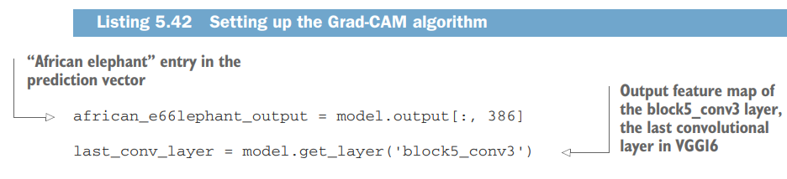

Slide 41
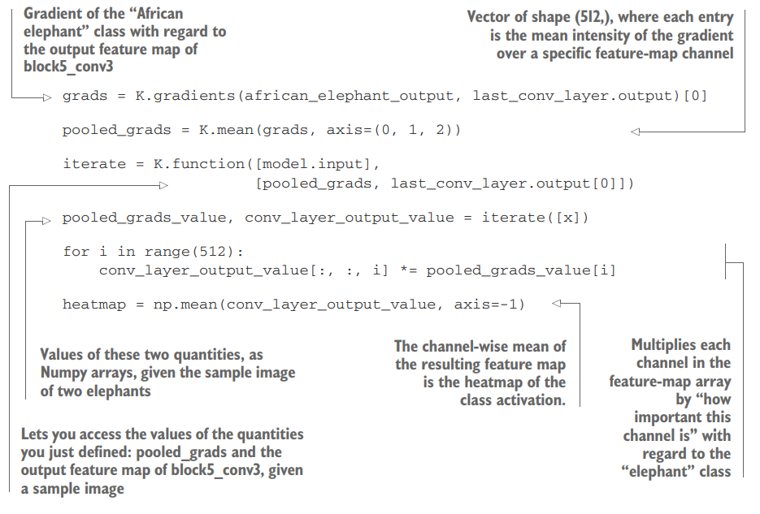

Slide 42
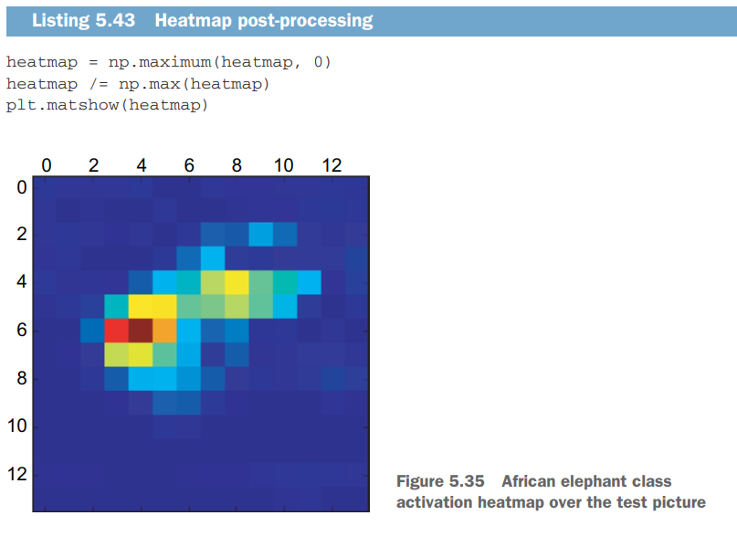

Slide 43
Super-impose the heatmap on original image
Finally, you’ll use OpenCV to generate an image that superimposes the original image on the heatmap you just obtained

Slide 44
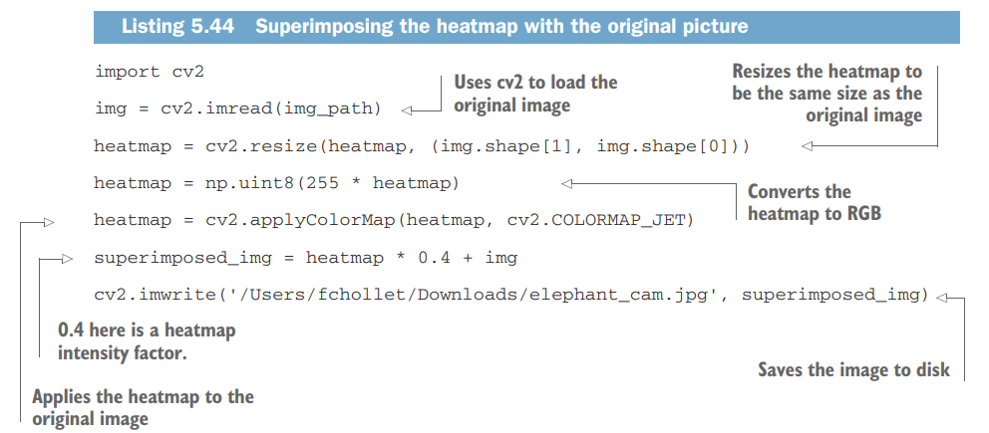

Slide 45
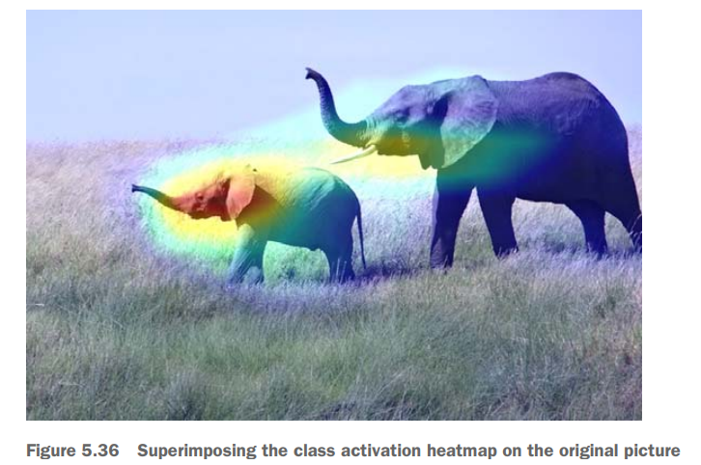

Slide 46
Two important questions
This visualization technique answers two important questions:
Why did the network think this image contained an African elephant?
Where is the African elephant located in the picture?
In particular, it’s interesting to note that the ears of the elephant calf are strongly activated: this is probably how the network can tell the difference between African and Indian elephants.

